Slide 1
Datathon 2021
ADFC German Bicycle Club
Team CCC-20 (Covid Cycling Conclusions)

Slide 2
Problem Description
Continue to demonstrate the critical value of biking infrastructure, especially in social crises. Advocate for increased support for accessibility of bike infrastructure because of how meaningful this is during disaster situations.

Slide 3
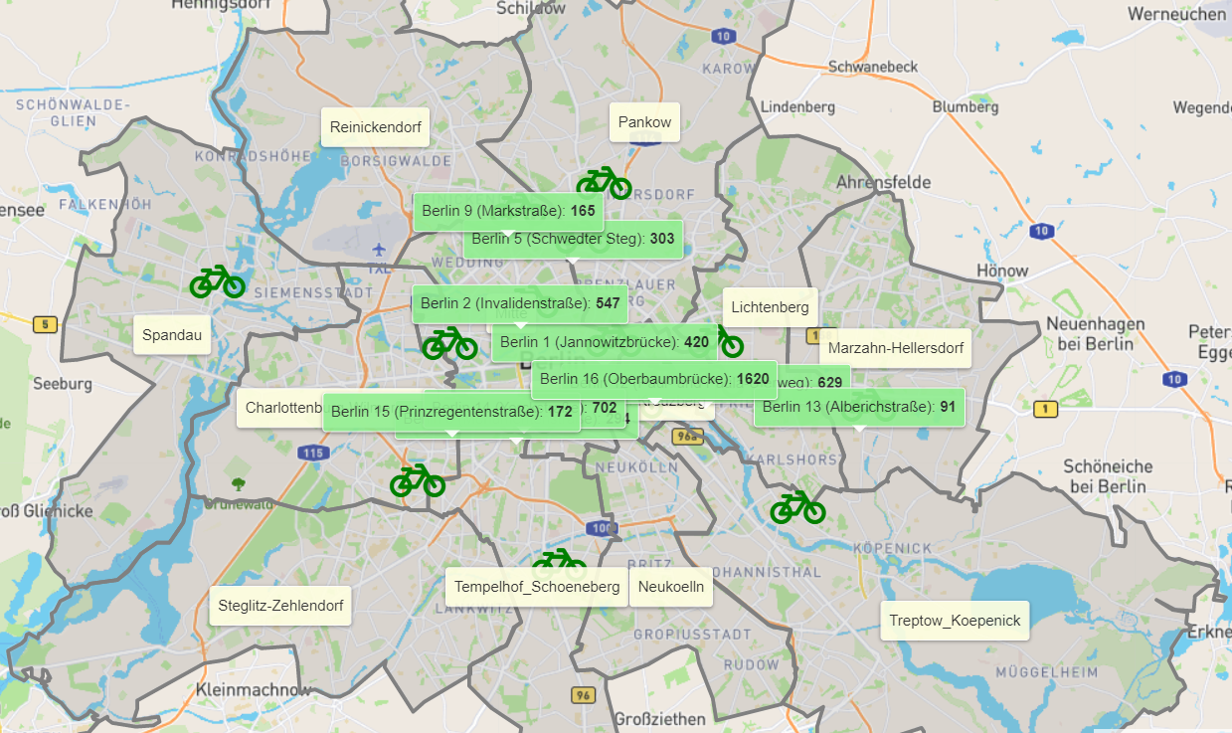
Visualisation
https://datathlon-bikes.herokuapp.com/bike_stations

Slide 4
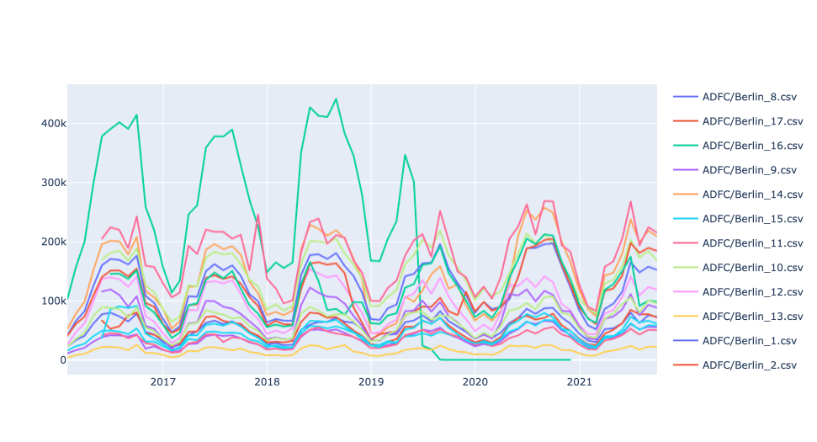
Findings
There was not enough data to demonstrate a strong correlation between a Berlin lockdown and cycling
Notes:
Oberbaumbrücke construction started in May 2019

Slide 5
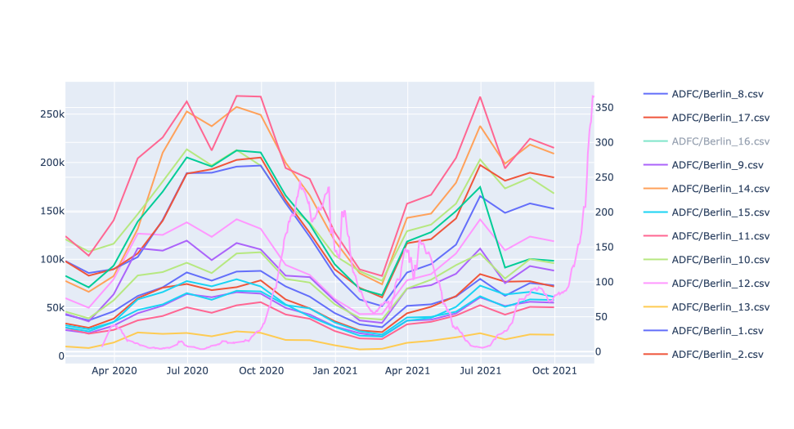
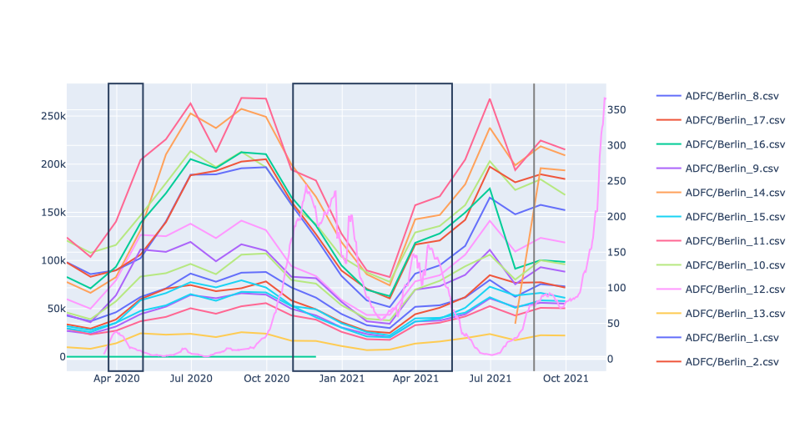
Findings
Highlighting lockdown and 3G restrictions
Notes:
black boxes: Lockdowns and 3G

Slide 6
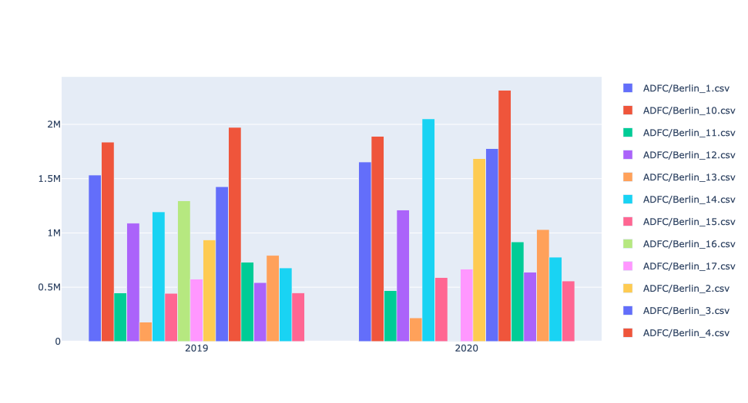
Findings Comparison 2019 - 2020

Slide 7
Findings Comparison 2019 - 2020
Station | 2019 | 2020 | Change in % | Street
Berlin_1 | 1532799 | 1653053 | 7,85% | Jannowitzbrücke
Berlin_2 | 933823 | 1683723 | 80,30% | Invalidenstr
Berlin_3 | 1425729 | 1776814 | 24,62% | Frankfurter Allee
Berlin_4 | 1971632 | 2315581 | 17,44% | Berliner Straße
Berlin_5 | 730920 | 916954 | 25,45% | Schwedter Weg
Berlin_6 | 542066 | 639822 | 18,03% | Klosterstraße
Berlin_7 | 791889 | 1030412 | 30,12% | Breitenbachplatz
Berlin_8 | 676975 | 776103 | 14,64% | Monumentenstraße
Berlin_9 | 445702 | 556630 | 24,89% | Markstraße
Berlin_10 | 1836270 | 1891728 | 3,02% | Maybachufer
Berlin_11 | 446900 | 467890 | 4,70% | Kaisersteg
Berlin_12 | 1088797 | 1211738 | 11,29% | Paul- und Paula-Uferweg
Berlin_13 | 177594 | 217001 | 22,19% | Alberichstraße
Berlin_14 | 1193433 | 2049992 | 71,77% | Yorckstraße
Berlin_15 | 443086 | 589432 | 33,03% | Prinzregentenstraße
Berlin_16 | 1296751 | 0 | - | Oberbaumbrücke
Berlin_17 | 574090 | 667394 | 16,25% | Mariendorfer Damm
Berlin_18 | - | - | - | Straße des 17. Juni

Slide 8
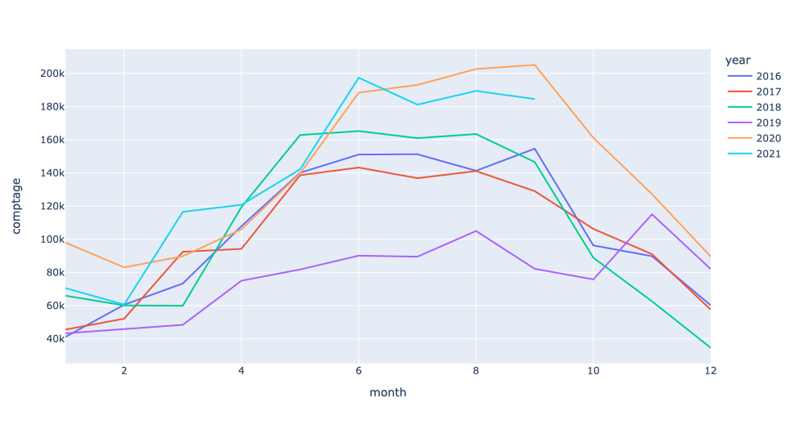
Findings: Hauptbahnhof
Isolated graph of traffic changes in Hauptbahnhof traffic in & around COVID lockdown years
Notes:
Station 2 (Invalidenstraße)

Slide 9
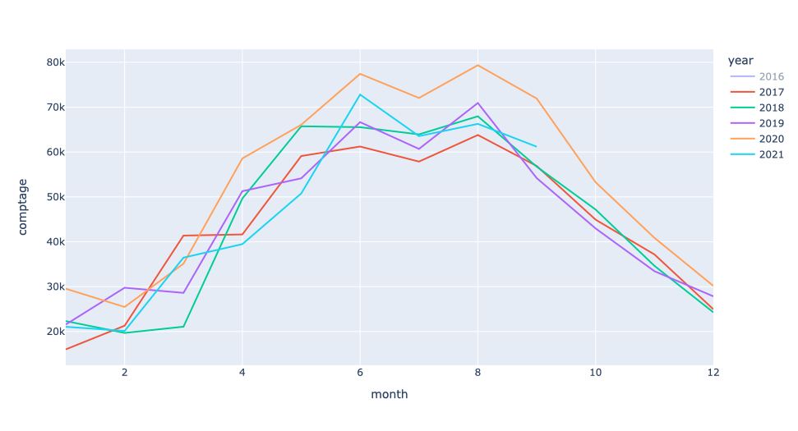
Findings: Klosterstraße (Spandau)
Notes:
Station 6

Slide 10
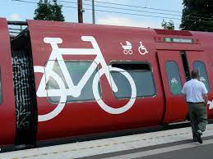
Next Steps: Proportion of Commuters
A potential next step is to calculate the proportion of cyclists in relation to public transit riders during and before lockdown periods
We hypothesize that there will be a decrease in ridership of public transit during the pandemic, therefore increasing the cycling proportion

Slide 11
Solution: Demonstrate the Value of Biking Infrastructure
Should the proportion of bikers during the lockdown in Berlin increase meaningfully, it is a strong demonstration of the critical nature of this infrastructure in public disaster situations.
Potential applications and action:
Prioritize clearing & salting bike lanes in winter months
Increase bike tooling stations around Hauptbanhof and other high traffic areas
Increase bike counting stations in more areas to gather more complete data about cycling in Berlin

Slide 12
Next Steps: Proposed Cycle Counters
Our group noticed that current cycle counters were not representing strong cycling communities outside the Ring.
Next steps:
Analyze population density data, which may suggest locations to fill in the gaps currently missing in the biking data
Consider proximity to natural features as a draw for more cyclists - developing strong infrastructure around these areas is also critical

Slide 13
Key Benefits
The most important advantages of the solution…
Our analysis suggests:
A case for advocacy of an increase in bike infrastructure investment
Strong case for prioritization of maintenance of bike lanes during months with challenging weather
Strong case for investment in beginner-friendly tools, such as tooling stations around high traffic areas
Strong case for an increase in bike counting stations to gather more complete data of this important public good/service

Slide 14
Resources Needed
Data:
Covid data for the city of Berlin are open data provided by LaGeSo (Landesamt für Gesundheit und Soziales).
Technology:
Python
Jupyter Notebooks
Heroku, Flask (website)
Expertise:
Python data analysis skills
Project management/ Public management knowledge
Analytics & statistics awareness

Slide 15
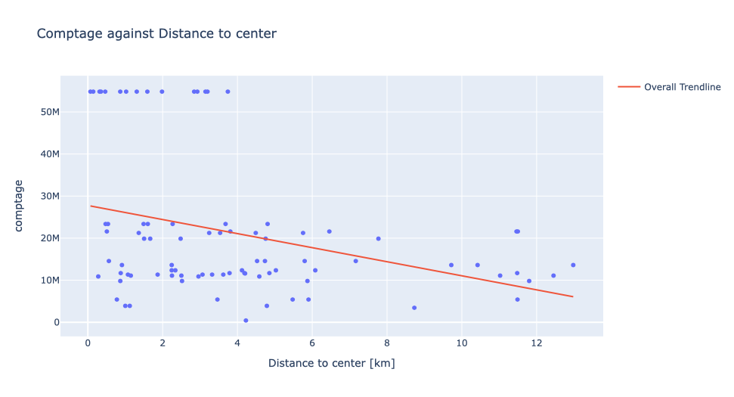
City center

Slide 16
Thank you!
Jake Pita
Vy Nguyen
Christine Cepelak
Giuditta Parolini

Slide 17
Findings
There was a meaningful change in the bike traffic at the Hauptbahnhof central station during lockdown in Berlin
(more than 100% of ridership in critical months such as September, which usually demonstrates low ridership)
Increase of comptage for almost every station from 2019 to 2020

Slide 18
Limitations, Risks & Lessons Learned
Data:
Counting station data was somewhat incomplete - not fully representative of all of Berlin
Technology: availability in organization, associated costs, reliability?
Expertise: lack of expertise, education?

